Slide 1
RESEARCH PROPOSAL

Slide 2
WRITING A RESEARCH PROPOSAL
A research proposal is similar in several ways to project proposal; however, a research proposal addresses a particular project: academic scientific research.
Research proposals contain extensive literature reviews and must offer convincing support of need for the research study being proposed.

Slide 3
ELEMENTS OF A RESEARCH PROPOSAL
1. title
2. abstract
3. study problem
4. research question
5. rationale/ relevance of the project
6. specific study objectives
7. research methods
i. study design
ii. Sample
iii. Data collection
iv. Statistical consideration
8. ethical consideration
i. consent form
ii. Privacy of information

Slide 4
ELEMENTS OF A TECHNICAL PROJECT PROPOSAL
1. Introduction
1.1. Problem Statement
1.2 Background
1.3 Needs statement
1.4 Objective
2. Proposed Technical Approach
2.1 Requirements
2.2 Architecture Design
2.3 Implementation Design
2.4 Quality Assurance Plan
3. Expected Project Results
3.1 Measures of Success
4. Schedule

Slide 5

1. Title

Slide 6
1. Title
Precise
Informative
Succinct
Interesting
Examples:
Improving Semantic Concept Detection through the Dictionary of Visually-distinct Elements
Human Action Recognition across Datasets by Foreground-weighted Histogram Decomposition
ICT-supported pedagogical policies and practices in South Africa and Chile: emerging economies and realities

Slide 7
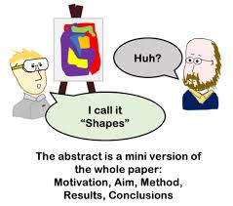
2. ABSTRACT WRITING

Slide 8
What is an Abstract?
An abstract is a self-contained, short, and powerful statement that describes a larger work.
An abstract is a brief summary of a research article, thesis, review, conference proceeding, or any in-depth analysis of a particular subject and is often used to help the reader quickly ascertain the paper's purpose

Slide 9
2. Abstract
It is a brief summarizing statement, usually 75-150 words long
An abstract includes these elements:
1. problem
2. method
3. result
4. conclusion

Slide 10
Types of Abstract
Informative
-Written after the project has been completed.
-Care is given to the results and conclusions
Descriptive
- It is written before the project is completed.
- Emphasis is on the problem and the method.

Slide 11
Sample 1
This paper explores privacy issues in relation to the growing prominence of marketing research and data mining in websites for children. Whereas increasing protection is given to individuals’ personal information, little attention is paid to information that is aggregated, electronically scanned, and sorted — despite the fact that aggregate information is often highly valued by the marketing industry. The authors review current trends in Internet market research, data mining techniques, policy initiatives, and the contents of some of the most highly frequented children’s game sites. The paper demonstrates how common data mining practices constitute a threat to children’s emerging rights online.

Slide 12
Sample 2
Human-robot collaborative work has the potential to advance quality, efficiency and safety in manufacturing. In this paper we present a gestural communication lexicon for human-robot collaboration in industrial assembly tasks and establish methodology for producing such a lexicon. Our user experiments are grounded in a study of industry needs, providing potential real-world applicability to our results. Actions required for industrial assembly tasks are abstracted into three classes: part acquisition, part manipulation, and part operations. We analyzed the communication between human pairs performing these subtasks and derived a set of communication terms and gestures. We found that participant-provided gestures are intuitive and well suited to robotic implementation, but that interpretation is highly dependent on task context. We then implemented these gestures on a robot arm in a human-robot interaction context, and found the gestures to be easily interpreted by observers. We found that observation of human-human interaction can be effective in determining what should be communicated in a given human-robot task, how communication gestures should be executed, and priorities for robotic system implementation based on frequency of use.

Slide 13
Standard Word Limit
100 to 250 words

Slide 14
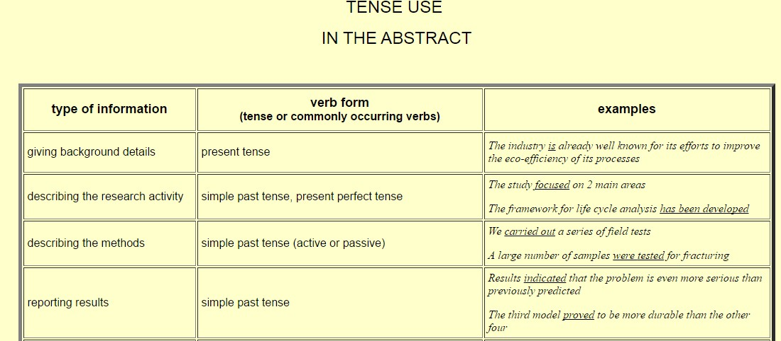

Slide 15
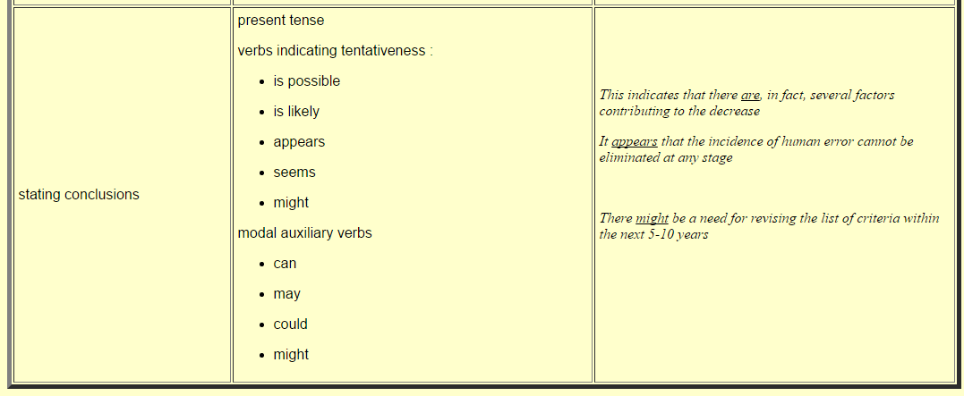

Slide 16
Informative Abstract Format (For Completed Study)
1) Motivation:
Why do we care about the problem and the results? If the problem isn't obviously "interesting" it might be better to put motivation first; but if your work is incremental progress on a problem that is widely recognized as important, then it is probably better to put the problem statement first to indicate which piece of the larger problem you are breaking off to work on. This section should include the importance of your work, the difficulty of the area, and the impact it might have if successful.
2) Problem statement:
What problem are you trying to solve? What is the scope of your work (a generalized approach, or for a specific situation)? Be careful not to use too much jargon. In some cases it is appropriate to put the problem statement before the motivation, but usually this only works if most readers already understand why the problem is important.

Slide 17
3) Approach:
How did you go about solving or making progress on the problem? Did you use simulation, analytic models, prototype construction, or analysis of field data for an actual product? What was the extent of your work (did you look at one application program or a hundred programs in twenty different programming languages?) What important variables did you control, ignore, or measure?
4) Results:
What's the answer? Specifically, most good computer architecture papers conclude that something is so many percent faster, cheaper, smaller, or otherwise better than something else. Put the result there, in numbers. Avoid vague, hand-waving results such as "very", "small", or "significant." If you must be vague, you are only given license to do so when you can talk about orders-of-magnitude improvement. There is a tension here in that you should not provide numbers that can be easily misinterpreted, but on the other hand you don't have room for all the caveats.

Slide 18
5) Conclusions:
What are the implications of your answer? Is it going to change the world (unlikely), be a significant "win", be a nice hack, or simply serve as a road sign indicating that this path is a waste of time (all of the previous results are useful). Are your results general, potentially generalizable, or specific to a particular case?

Slide 19
Abstract as a whole…
Motivation
Problem statement
Methodology
Results and conclusion

Slide 20
The Research Problem
Focus on four things;
context
issue
relevance
and objective
Example:
Implementation of computer technology in an institute

Slide 21
Guidelines: Selecting and Defining the Problem
Criteria to help you select and define your problem:
Is the problem important or significant? Is the question worthwhile for the expenditure of time, energy, and funds involved? What is its societal relevance?
Can the problem be stated in question form? (Finding the answer then becomes the objective of the study.)
Can the problem be delimited and narrowed? Can boundaries be defined?
Are resources of information available and the state of the art practical?
Does it interest you?
Do you have the required background to undertake the inquiry under question?

Slide 22
Research Question
A research question is the question that the research project sets out to answer.
In actual fact, a research study may set out to answer several questions.
The methodology used for a research study, and the tools used to conduct the research, all depend upon the research questions being asked.

Slide 23
IMPROVE YOUR SCIENCE AND RESEARCH VOCABULARY
http://www.phrasebank.manchester.ac.uk/

Slide 24
Research Proposal Form
Group Members: 5-6 members
Research Problem: Derive a problem from a paper from the Journal of Computer Assisted Learning
Research Question :__________________________________________________________________________________________________________________________________________
Purpose:
Relevance and Benefits of the study:
Literature Review (Brief synthesis of 2-3 papers, to justify your problem statement, for the proposal phase)__________________________________________________________________

